Slide 1
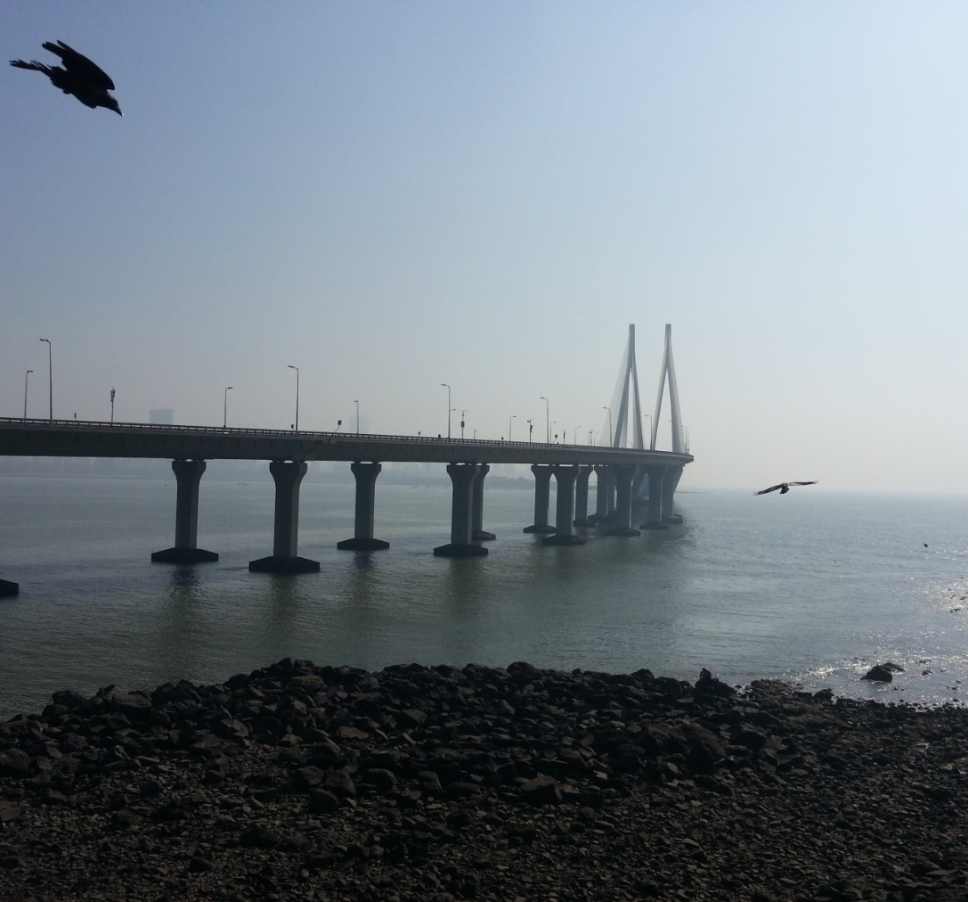
Rover therapist…
Shubham Chandak (47008) Ridhima Joshi (47020)
Madhur Lahoti (47028)
Guided By:
Mr. C. A. Ghuge

Slide 2
Introduction
CRM
Optimal Path
Path Tracking
Fare Calculation
Complaint Launch

Slide 3
Literature Survey
Customer Relationship Management Using Android Phone in Tourism
International Journal of Emerging Technology and Advanced Engineering Website: www.ijetae.com (ISSN 2250-2459, ISO 9001:2008 Certified Journal, Volume 4, Issue 3, March 2014
By: Nitin Khondre, Ravi Saini, Ronak Jain, Sarang Suryawanshi, Bushra Quazi ).
inGuide-Interactive Guide
2009 3rd IEEE International Conference on Digital Ecosystems and Technologies Future Mobile CRM in Automotive and Tourist Area.
(By: Filipe Andre Gomes Batista, Nuno Rodrigues, Alexandrino Goncalves)

Slide 4
Cont…
Landmark based Shortest Path Detection by using Dijkestra Algorithm and Haversine Formula
(International Journal of Engineering Research and Application
By: Dr. P.V.Ingole, Mr.Mangesh K Nichat).
Overview on Android-The New Mobile Operating System
SGI Reflections-International Journal of Science, Technology and Management Website: www.ijstam.com (ISSN 0976-2140, Volume 2, Issue 3, April 2011
By: Monika Bazard, Sonia Bhardwaj ).

Slide 5
Proposed System
Problem Statement:
To develop user friendly android application for tourist which guides them to explore.
Scope:
Limited to Maharashtra State.

Slide 6
Cont…
Objectives:
Navigate to current location
Listing tourist attractions
Fare calculation
Lodge complaint
Guide the tourist
Optimal path tracking
Auto fare calculation
Places history with images

Slide 7
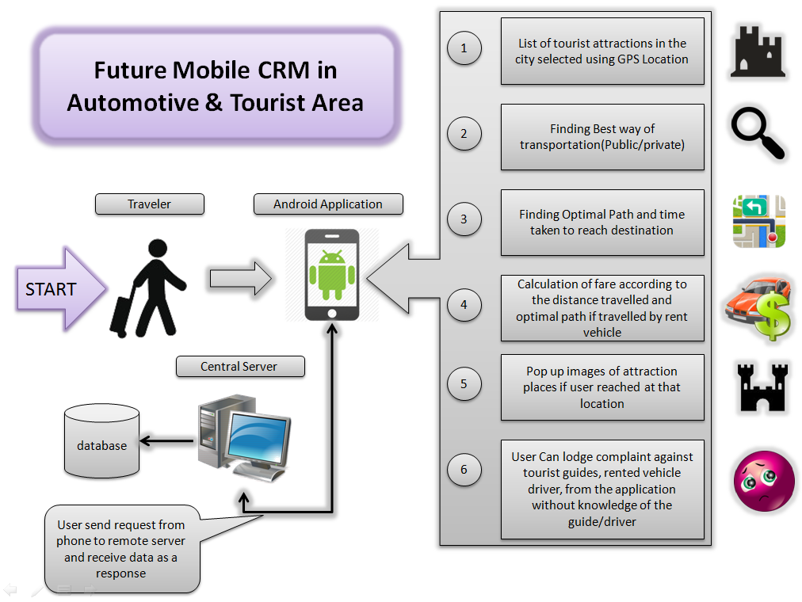
Fig: System Architecture

Slide 8
Project Flow
System Initialization
Listing Tourist Attractions
Optimal Path Tracking
Pop up image
Fare Calculation
Lodge Complaint

Slide 9

HAVERSINE Algorithm
It is used to calculate the distance between two points on the Earth’s surface specified in latitude and longitude.
Where d id the distance between two points with longitude and latitude(Φ,Ψ)
r is the radius of the Earth

Slide 10
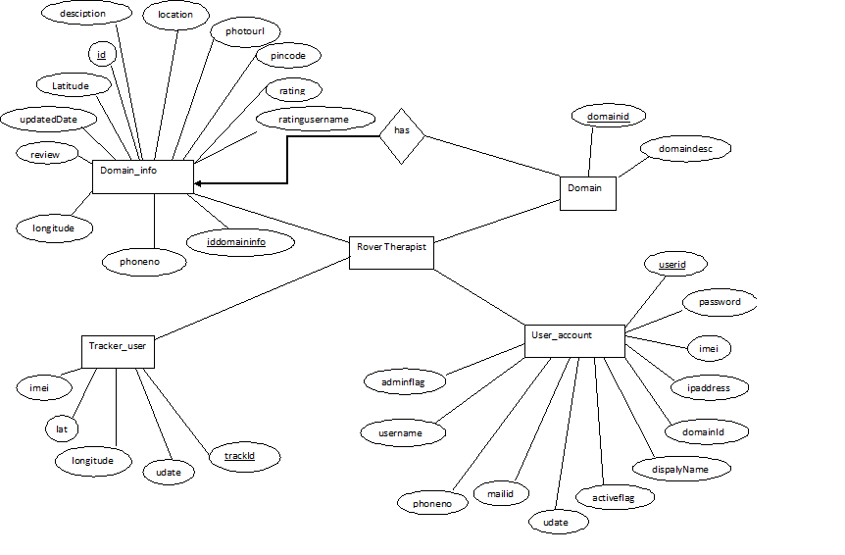
ER DIAGRAM

Slide 11
Technologies used for web based module
HTML
Android
Java
JavaScript
MySQL database

Slide 12
Flow of Server login page
Login page
Index.jsp
{on submit button}
Ajax.jsp
Execute database query
Returns response
Ajax.jsp
Index.jsp
menu

Slide 13
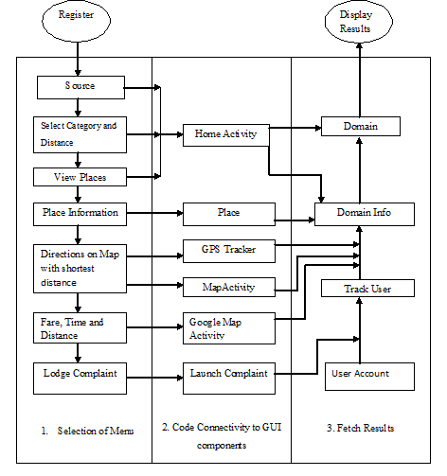
SYSTEM ARCHITECTURE

Slide 14
Admirable Features
Image pop-up
Alert Messages if the Route is diverted
Seasonal Classification
Places list as per location
Text to speech
Auto fare calculation

Slide 15
Future Scope
Live Traffic
Climate Alert
Country

Slide 16
Advantages and Disadvantages
Advantages:
User can get tourist places from any local area with all description.
Displays route on Map
User can see fare of local taxi
Facility to launch complaints
Pop up’s images
Disadvantages:
Requires Internet on phone

Slide 17
Conclusion
Enhanced CRM core processes
Interactive CRM processes between business and customers
The app enable a nearly 24h accessibility

Slide 18
Thank
You!!

